Slide 1
Submitting a Genome to RAST

Slide 2
Uploading Your Job
Login to your RAST account. You will need to register if this is your first time using SEED technologies to work with your genome.
Click on the “Upload a new job” link.
Click here!

Slide 3
RAST Step 1
Select a file containing the sequence of the genome you wish to submit for annotation.
*Files must be in FASTA or in Genback format.

Slide 4
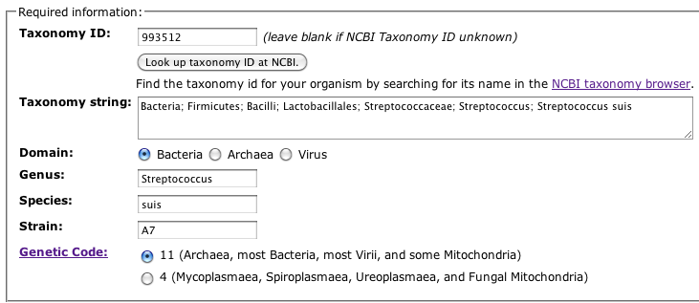
RAST Step 2
Use NCBI’s Taxonomy Browser (available at: http://www.ncbi.nlm.nih.gov/taxonomy)
to locate your genome’s Taxonomy ID.
RAST will use this data to complete the remaining fields automatically.
1.
2.
3.

Slide 5
RAST Step 3
Input the required information, and click on “Finish the upload” to proceed.

Slide 6
Viewing your Results
You can access the Jobs Overview page to track RAST’s progress on your genome.
Once the system is finished annotating your genome, click on “view details” to access the data and other tools available for genome analysis.

