Slide 1
Deleting, Finding, and Inserting Genes

Slide 2
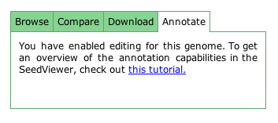
User Privileges
Before beginning, make sure you have annotation privileges for your genome!
These settings can be accessed from the Organism Overview page.

Slide 3
Deletions
Deletions are straightforward in the SEED genome browser. From the gene page, you can select “Delete feature” to eliminate a gene from your genome.

Slide 4
Finding a Gene
To search for the missing DnaA gene (that was deleted), select “Function-based comparison” from the Comparative Tools drop-down menu. Select a related organism to compare your genome with. We then narrowed our search focus to genes in the related organism but not in ours. From here, we searched directly for the DnaA gene.

Slide 5
Finding a Gene
Clicking on “Find” launches a targeted search for the specified gene. Here, the system found where the DnaA gene should be in our organism. Clicking on the “Q” takes us to the Gene Editor page. To determine the proper location of the gene, it may be necessary to look at the DnaA gene in other organisms or access more detailed information from external sources.

Slide 6
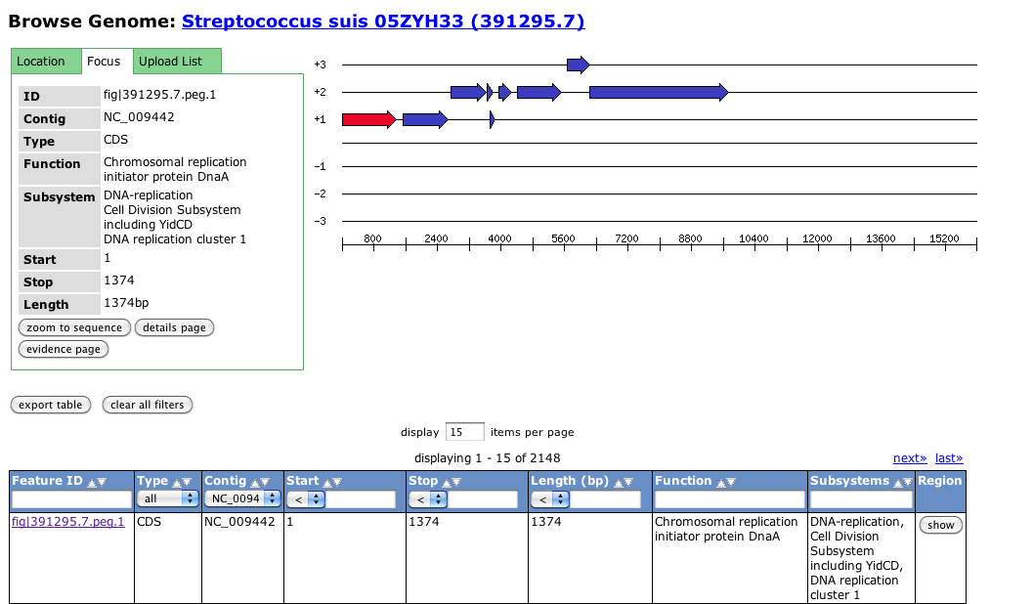
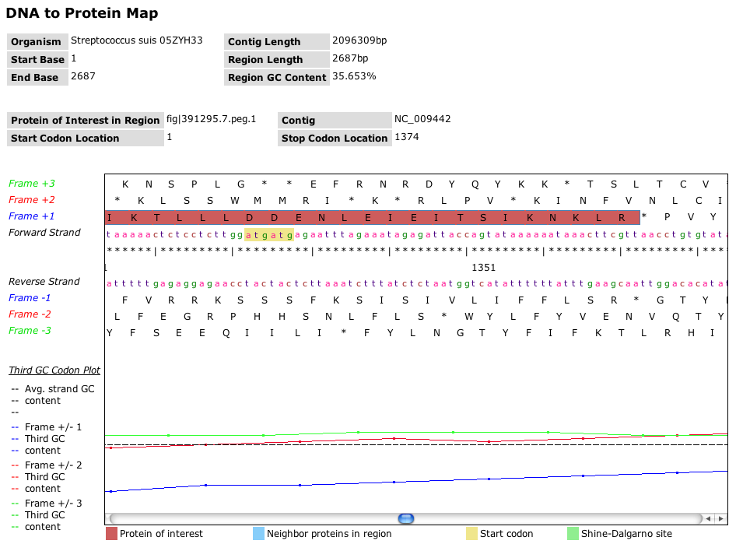
Determining the Correct Sequence
Through comparison with another strain of Streptococcus suis, we found sequences surrounding the correct start and stop codons to use to guide our insertion of the DnaA gene into the Streptococcus suis A7 sequence.

Slide 7
Creating a Feature
Note that white regions denote the region similar to the template gene, while grey indicates the region outside the template similarity. >>> denotes a gene on the same strand, and <<< denotes a gene on the opposite strand.
Once you have specified the correct start and deselected any spurious stop codons, click on “create” to create the gene in your genome.

Slide 8
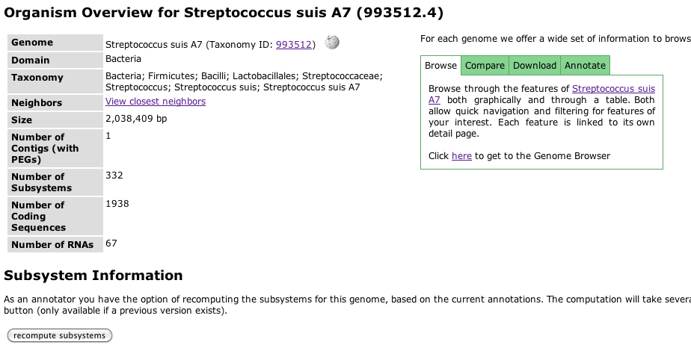
Recomputing Subsystems
After having inserted a gene, recompute the subsystems in the organism from the Organism Overview page.

