Slide 1
Manual Improvements to a RAST annotated genome: Deleting, Finding and Inserting Genes

Slide 2
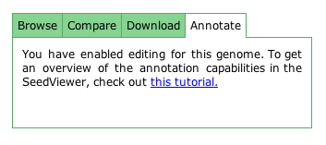
User Privileges
Before beginning, make sure you have annotation privileges for your genome!
These settings can be accessed from the Organism Overview page.

Slide 3
Deletions
Deletions of genes can be performed from the corresponding protein page. Click the “Delete feature” button to eliminate a gene from your genome.

Slide 4
Deletions

Slide 5
Finding an uncalled Gene
To search for the missing DnaA gene (that was deleted in the previous slide), use the “Function-based comparison” tool from the Comparative Tools drop-down menu. Select a related organism (B) to do a comparison with your genome (A). Narrow the search focus to genes that are present in the related organism but not in yours (B only). Search for the DnaA gene by typing “DnaA” into the search field in the header of the Functional role column. This approach will work only for features that are in subsystems as the “Functional-based comparison tool” compares only those.

Slide 6
Finding a Gene

Slide 7
Finding a Gene
Clicking on “Find” launches a targeted search for the specified gene. Here, the system found where the DnaA gene should be in our organism. Clicking on the red arrow marked “Q” opens the Gene Editor page. To determine the proper location of the start codon, it may be necessary to look at the DnaA gene in other organisms or access more detailed information from external sources.

Slide 8
Finding a Gene

Slide 9
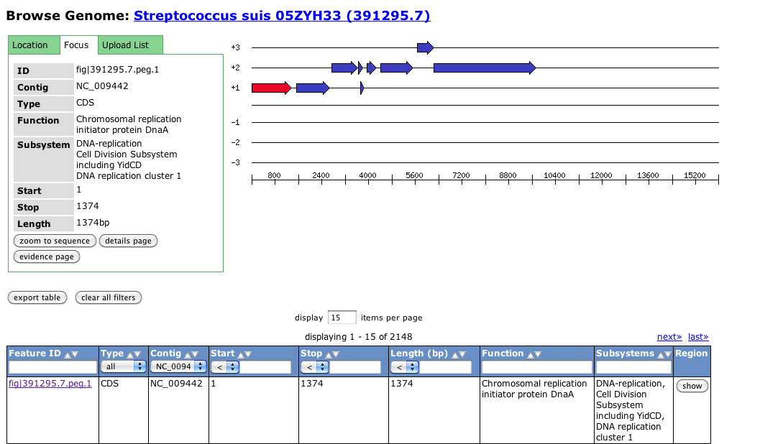
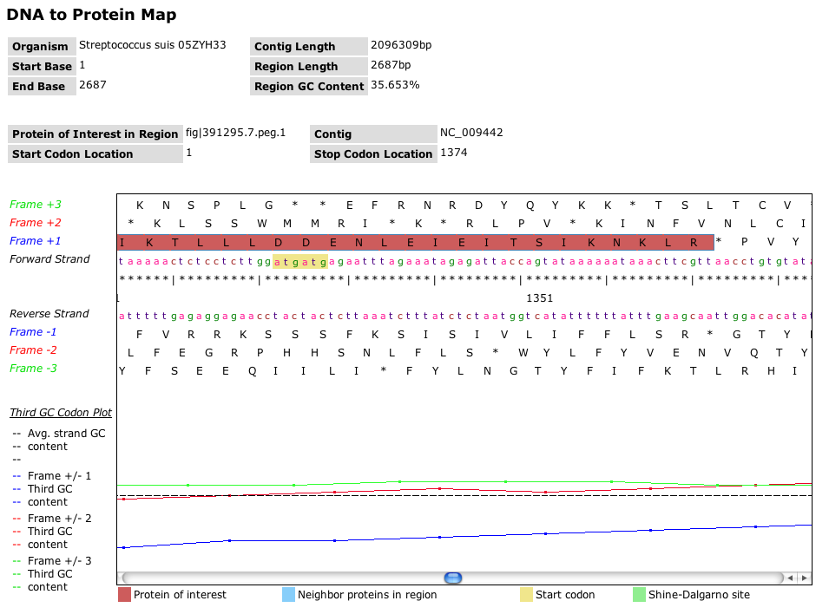
Determining the Correct Sequence
A comparison with another strain of Streptococcus suis, can help find the correct start and stop codons to guide the insertion of the missing DnaA gene.

Slide 10
Creating a Feature
The “Gene editor” colors sequences similar to ribosomal binding sites (rbs) blue and provides radio buttons on potential start codons (green). By checking the appropriate radio button the start of the DnaA gene can be set. White regions denote the region similar to the template gene, while grey indicates regions outside the template similarity. By clicking the “create” button the open reading frame from the marked start codon to the first “unchecked” stop codon (red) will be used to create the DnaA gene. Spurious stop codons can be deselected by checking and the next unchecked stop codon will become the end of the gene.

Slide 11
Creating a Feature

Slide 12
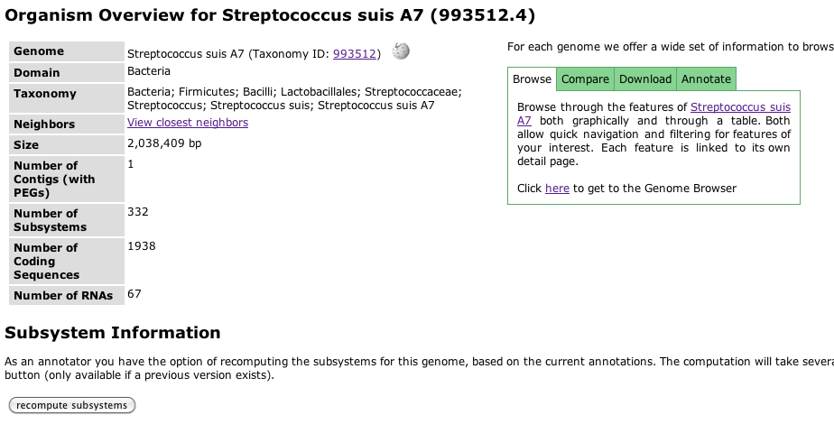
Recomputing Subsystems
After having inserted a gene that was missing in the Functional Comparison table, the subsystems in your genome can be recomputed from the Organism Overview page.

