Slide 1
Improving RAST annotations within RAST
Veronika Vonstein
Fellowship for Interpretation of Genomes
December 2008

Slide 2
Your genome after RAST

Slide 3
SEED genome in RAST

Slide 4
Use Function based comparison tool

Slide 5
Choose genome to compare to

Slide 6
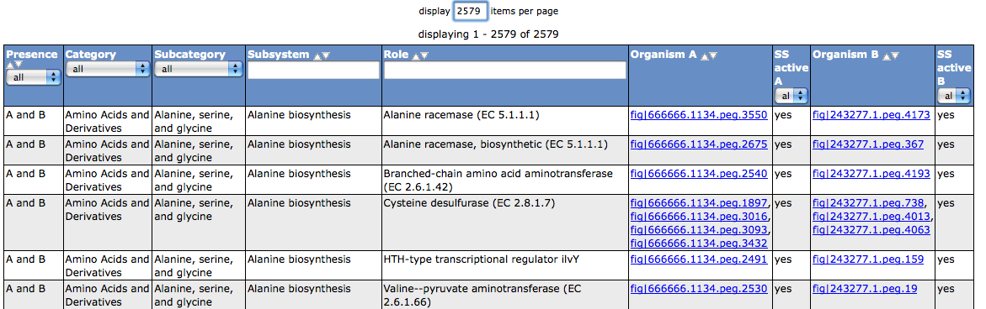
Compare Metabolic Reconstruction of your genome (A) and the SEED genome (B)

Slide 7
1. Case: Candidate present but Function different
But to eliminate the risk of annotating a paralog

Slide 8
Compare Regions

Slide 9
Annotate Chromosomal Clusters

Slide 10
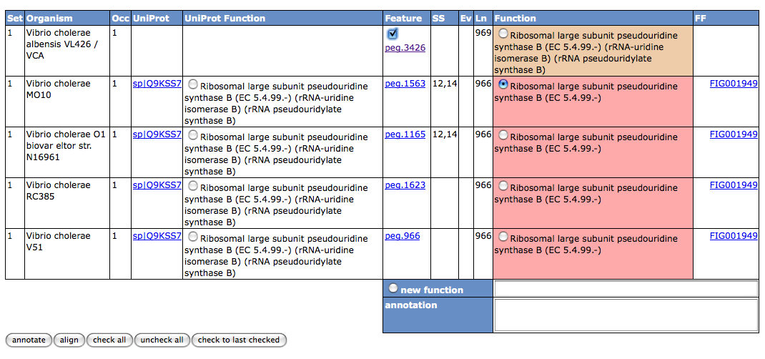
Annotate set 1

Slide 11
Set 1 done continue

Slide 12
2. Case: The real missing

Slide 13
3. Case: Missed gene call

Slide 14
Your genome after RAST

Slide 15
Your improved genome

Slide 16
Summary
Re-annotated 490 gene functions
Increased the number of pegs in subsystems from 36% to 50%
This added 60 subsystems to the metabolic reconstruction of your genome
Possible to add missed genes, annotate them and connect them to subsystems

